Slide 1
The compositing problem
How to model overlap? It could be any where from
zero overlap to…
total overlap
A pixel

Slide 2
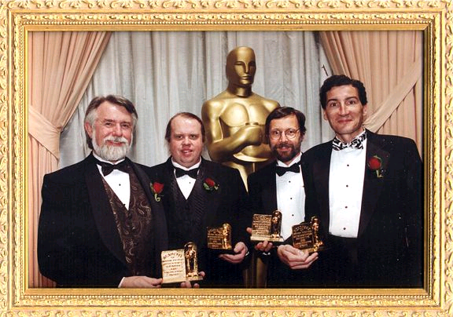
Tom {Porter | Duff}
Tom Duff and Tom Porter took on the challenge of studying the alpha channel in a rigorous manner
July 1984
Recall Catmull / Smith made their contribution in 1977

Slide 3
Porter Duff model
Defined a standard model for the compositing problem
Leads to 12 basic operations
AB
A
B
background

Slide 4
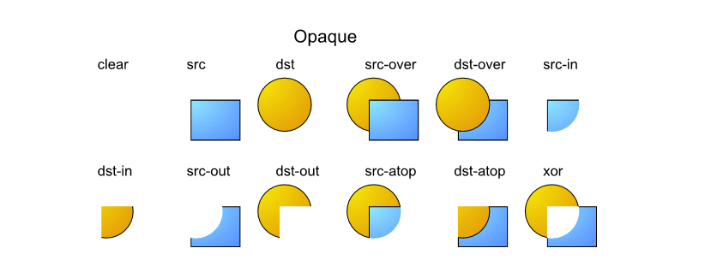
The Porter Duff ops
http://www.svgopen.org/2005/papers/abstractsvgopen/index.html#S5.
Different authors use different names such as ‘held-out-by’ rather than src-out but concepts are identical

Slide 5
Covering a pixel
(bg) +
(A) +
(B) -
(both)
A has α_{A} (0-1)
B has α_{B} (0-1)
Coverage should sum to 1
(1- α_{A})(1- α_{B}) +
α_{A}+
α_{B} -
α_{A} α_{B}
AB
A
B
background

Slide 6
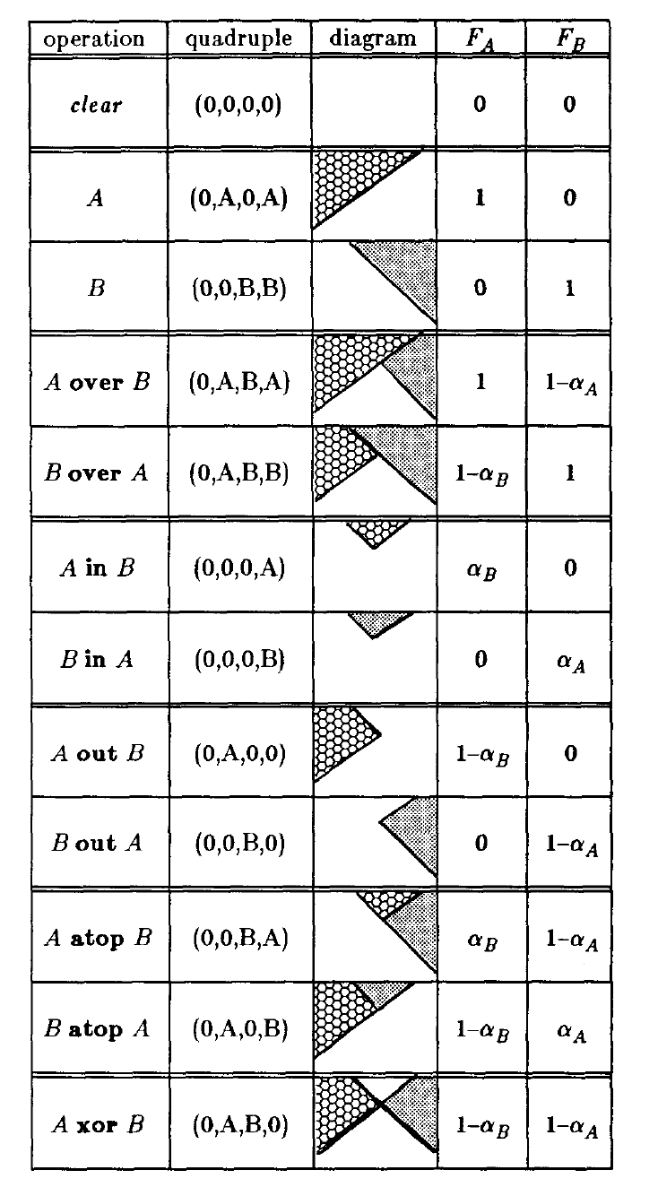
The Porter Duff ops
1984 diagram at right
How to read (examples):
A over B: Draw A where A is and B where A isn’t
B out (held out by) A Don’t draw any A and draw B where A isn’t
A atop B Draw A where B is and draw B where A isn’t
A xor B Draw A where B isn’t and draw B where A isn’t

Slide 7
Do we really NEED to store RGBA?
If our primary purpose is to composite:
No … each chroma channel gets multiplied by its α somewhere so why not store just RGBA already premultiplied
Saves time, saves space

Slide 8
Do we really NEED to store RGBA?
But there’s no free lunch
If stored as ints, the multiplication loses info
Even if stored as floats, we often can’t directly view a premultiplied image (why?) – we will have to un-premultiply (and we won’t know how if we don’t store α)
In the end, it depends

Slide 9
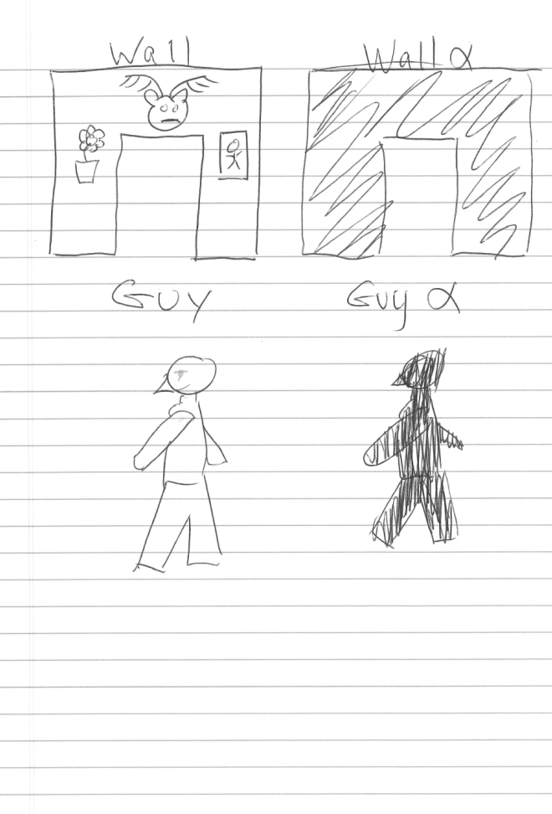
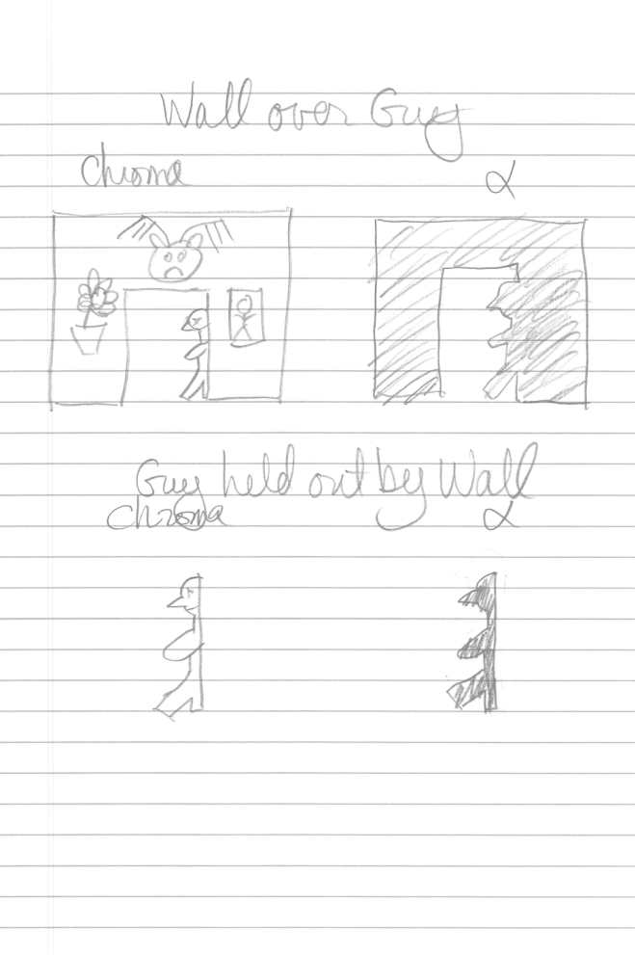
Real world example

Slide 10
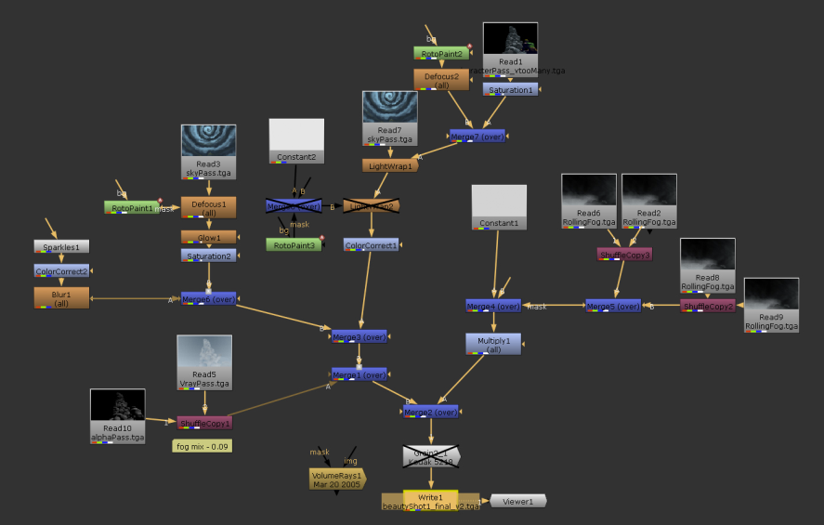
Real world use
The Nuke (and others) UI is based upon an inverted tree where each node is a binary or monadic operator
Such as the Porter Duff operators
Deep bushy trees are common
This one barely scratches the surface
http://missing-frame.com/wp-content/uploads/2011/03/week9_nuke.jpg

Slide 11
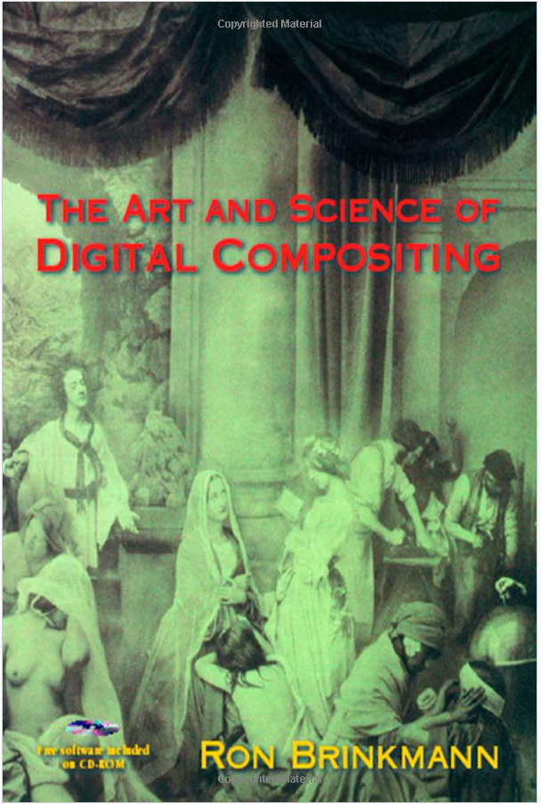
The definitive text
Ron Brinkmann’s The Art and Science of Digital Compositing
Among the senior founding technical members of Sony Pictures Imageworks
And all-around great guy

Slide 12
OpenGL
Enable blending
glEnable(GL_BLEND)
Specify blending factors
glBlendFunc(GLenum srcfactor, Glenum destfactor)
srcfactor refers to foreground (fragment being processed)
destfactor refers to background (pixel buffer)
For our example, A over B, use these input values:
glBlendFunc(GL_ONE, GL_ONE_MINUS_SRC_ALPHA)

Slide 13
OpenGL
Some other tips:
When using a depth buffer, draw opaque objects first, then make the depth buffer read-only to draw translucent objects
glEnable(GL_DEPTH_TEST) //enables depth buffer
//opaque objects
glDepthMask(GL_FALSE) //makes depth buffer read-only
//translucent objects
Disable blending after all objects are drawn
glDisable(GL_BLEND)

